Slide 1
COMPUTER NETWORKS
CS610
Lecture-3
Dr. M. Sheraz Arshad Malik

Slide 2
Types of Multiplexing
Frequency Division Multiplexing (FDM)
Wave Division Multiplexing (WDM0)
Time Division Multiplexing (TDM)

Slide 3
Review Lecture 2
Resource Sharing
Growth of the Internet
  Linear Scale
  Log Scale
Tools for Probing the Internet
  PING
  TRACE ROUTE

Slide 4
CHAPTER No. 4
TRANSMISSION MEDIA

Slide 5
Basic Idea
Encode data as energy and transmit energy
Decode energy at destination back into data
Energy can be electrical, light, radio, sound, ...
Each form of energy has different properties and requirements for transmission

Slide 6
Transmission media
Transmitted energy is carried through some sort of medium
Transmitter encodes data as energy and transmits energy through medium
  Requires special hardware for data encoding
  Requires hardware connection to transmission medium

Slide 7
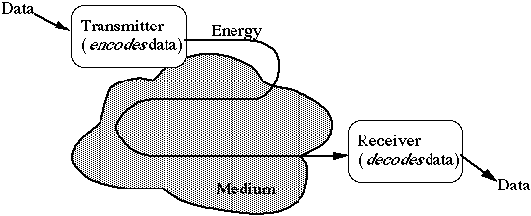
Transmission media
Media can be copper, glass, air, ...

Slide 8

Copper Wires
Widely used because of low resistance to electric current, inexpensive and easy to install
Twisted pair wires
  Two insulated copper wires twisted together to reduce Interference
  Examples: Telephone wiring (one pair).LAN wiring UTP cable (4 pairs of copper wire)

Slide 9
Types of Media
GUIDED Media:
Uses physical path
      Examples: copper wires, optical fiber, coaxial cables etc.
UNGUIDED Media:
Uses no physical path
      Example: Radio waves

Slide 10
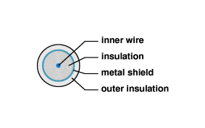
Coaxial Cable
Single wire surrounded by an insulation and a metal shield against interference
Example use: Cable TV wiring and early LAN wirings

Slide 11
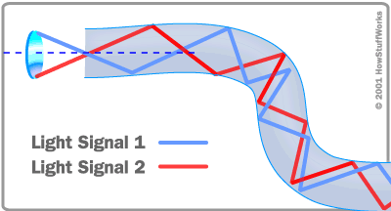
Optical Fibers
Uses light to transport data

Slide 12
Advantages of Optical Fibers
Neither causes nor susceptible to electrical interference
Can carry pulse much farther than copper
Light can encode more information than electric
One single fiber is sufficient to carry data

Slide 13
Radio
Used for public radio and TV broadcast
Data transmission is said to operate at Radio Frequency (RF)
Transmission range depends on antenna size

Slide 14
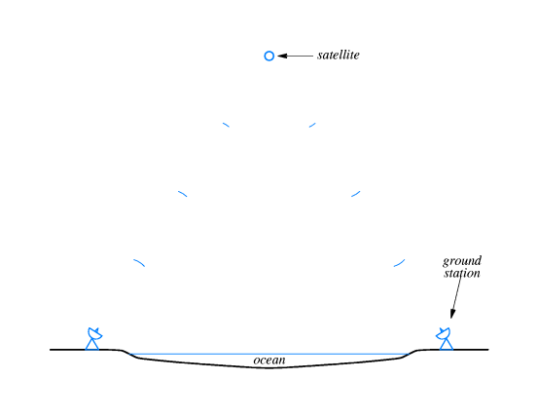
Satellites
Satellites for long distance transmission
Satellite transponders receive, amplify, and transmit the RF signal back to the ground

Slide 15
Geosynchronous Satellites
Placed in an orbit (at 35,785 km or 22,223 miles above the earth) that is exactly syncronized with the rotation of the earth
From the ground, it appears to stay at the same position at all times

Slide 16
Low Earth Orbit Satellites
Rotates faster than the rotation of the earth at 200 to 400 miles above the earth
They do not appear to remain stationary
Low Earth Orbit Satellite Arrays is a set of satellites communicating with each other and with the earth surface

Slide 17
Microwave
Electromagnetic radiation beyond the frequency range used for radio and TV
It can be aimed in a single direction
Can carry more information than low frequency RF transmissions

Slide 18
Infrared
Remote controls used with TV etc uses IR
Inexpensive wireless communication
Limited to a small area
Convenient for portable computers

Slide 19
CHAPTER No. 5
LOCAL ASYNCHRONOUS COMMUNICATION
(RS-232)

Slide 20
Introduction
Computers use binary digits (0s and 1s) (bits) to represent data
Computers communicate by sending bits through a transmission medium (i.e. cable, air).
This chapter describes how electric current is used to send digital information across Short Distances

Slide 21
The Need For Async Communication
In asynchronous communication the sender and receiver do not need to coordinate (synchronize) before the transmission begins
In an asynchronous system, the receiving hardware must be ready to accept and interpret the signal whenever it arrives

Slide 22
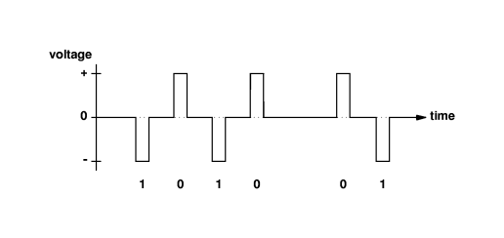
Using Electric Current to Send Bits
A small electric current is used to encode data
Example: Negative voltage to represent a 0 bit, positive voltage to represent a 1 bit.

Slide 23
Standards For Communication
Standard specifies both the timing of the signals and the electrical details of voltage and current
RS232-C (by EIA) is one of the most widely used standard to transfer characters between a computer and a device such as modem, keyboard etc.
RS-232 defines a serial (bits are sent one after another) asynchronous communication

Slide 24
RS232-C Specifications
Cable length < 50 feet (20mt)
-15v (bit 1) , +15v (bit 0)
One character => 7 or 8 data bits
No delay between character bits
When idle, puts -15v (bit 1) on the wire
Each character start with a start bit(0), and end with a stop bit(1)

Slide 25
Baud Rate, Framing, And Errors
Baud rate:
  The number of changes in the signal per second
For simple RS-232, Baud rate = Number of bits/sec
If the voltage measurements do not all agree or if the stop bit does not occur exactly at the same time expected, framing errors occur

Slide 26
Full-Duplex Asynchronous Comm
Electrical circuits require at least two wires, one of them to carry the data signal, the other is used as the return path, called ground
Simultaneous transfers in two directions are known as full-duplex transmission

Slide 27
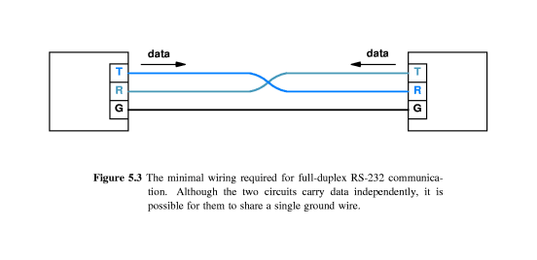
Full-Duplex Asynchronous Comm

Slide 28
CHAPTER No. 6
LONG DISTANCE COMMUNICATION
(Carriers, Modulation and Modems)

Slide 29
Long Distance Communication
Electric current becomes weaker as it travels over copper
Signal loss occurs when RS232 is attempted to use to communicate to a remote site
A continuous, oscillating signal, called a Carrier, propagates farther than other signals

Slide 30
Modulation
To send data, a transmitter slightly modifies the original information by using a carrier
Such modifications are called “Modulation”
The receiver
  monitors the incoming carrier,
  detects modulation,
  reconstructs the original data, and
  discards the carrier

Slide 31
Types of Modulation
Three of the modulation schemes are:
  Amplitude Modulation (AM)
  Frequency Modulation (FM)
  Phase Modulation (PM)

Slide 32
Modem
A Modulator is a hardware circuit that
  accepts a sequence of data bits
  applies modulation to a carrier wave according to the bits
A Demodulator is a hardware circuit that
  accepts a modulated carrier wave and
  recreates the sequence of data bits
A Modem is a hardware that combines both modulator and demodulator in a single device

Slide 33
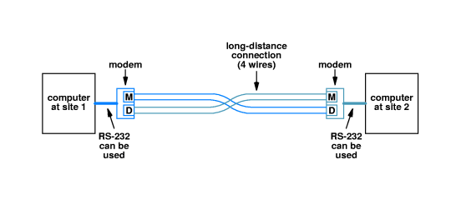
Modem

Slide 34
Multiplexing
Q: How can two or more signals can be transmitted simultaneously over a single wire ?
A: By using different carrier frequencies

Slide 35
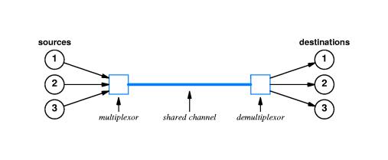
Career Frequencies And Multiplexing
Frequency division multiplexing (FDM)
  Using multiple carrier frequencies to allow independent signals, to travel through a medium

Slide 36
Wavelength Division Multiplexing (WDM)
FDM concept applied to the optical transmission systems (optical fibers) is known as Wave Division Multiplexing

Slide 37
Time Division Multiplexing (TDM)
Sources sharing a medium “take turns” to send data
Synchronous TDM gives each source an opportunity to send data
Statistical TDM does not give chance to a source that does not have data to send

